Slide 1


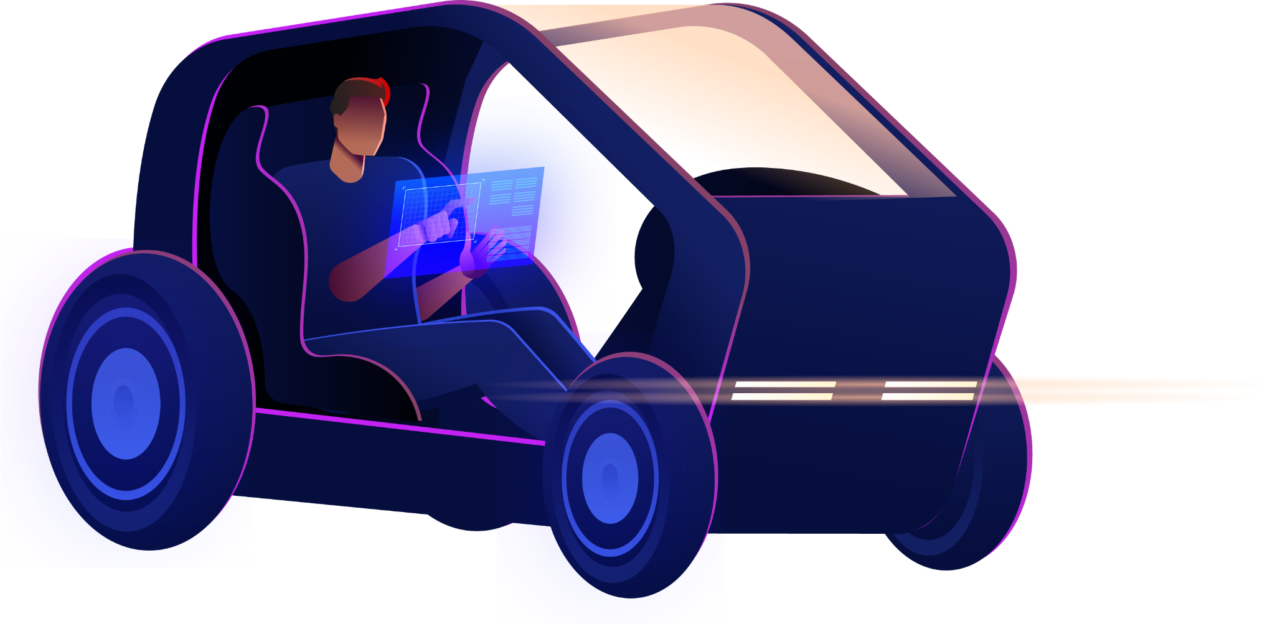


Collision Scenario Analysis
for Autonomous Vehicle Testing
DATA298B
Dr. Jerry Gao, Dr. Lee C. Chang
Group 4: Johnny Qiu, Lin Zhu, Manyu Zhang, Yuan Pan

Slide 2

Table of Contents
01
02
03
04
05
06
07
08
Project Study Question
Data Pre-processing
Data Preparation
Data Analytics Results
Proposed ML Models
ML Results & Comparison
System Design & Demo
References & QA

Slide 3



01
Project Study Question

Slide 4
Motivation & Target Problem
Needs
Current safety testing methods do not cover all cases of real-world driving, such as extreme collision, etc. Need full coverage especially for collision scenarios.
Motivation
Make real-world collision cases testable.
Target Problem
Extract all conditions and involved objects in real-world collision scenarios to re-construct these scenarios for AV testing.

Slide 5
Deliverables
Models trained to extract objects & conditions from collision scenarios.
A collection of real-world AV collision cases with all necessary conditions and objects extracted, used for AV testing.
A web portal showcasing all the objects detected and conditions involved in the testing scenarios.

Slide 6
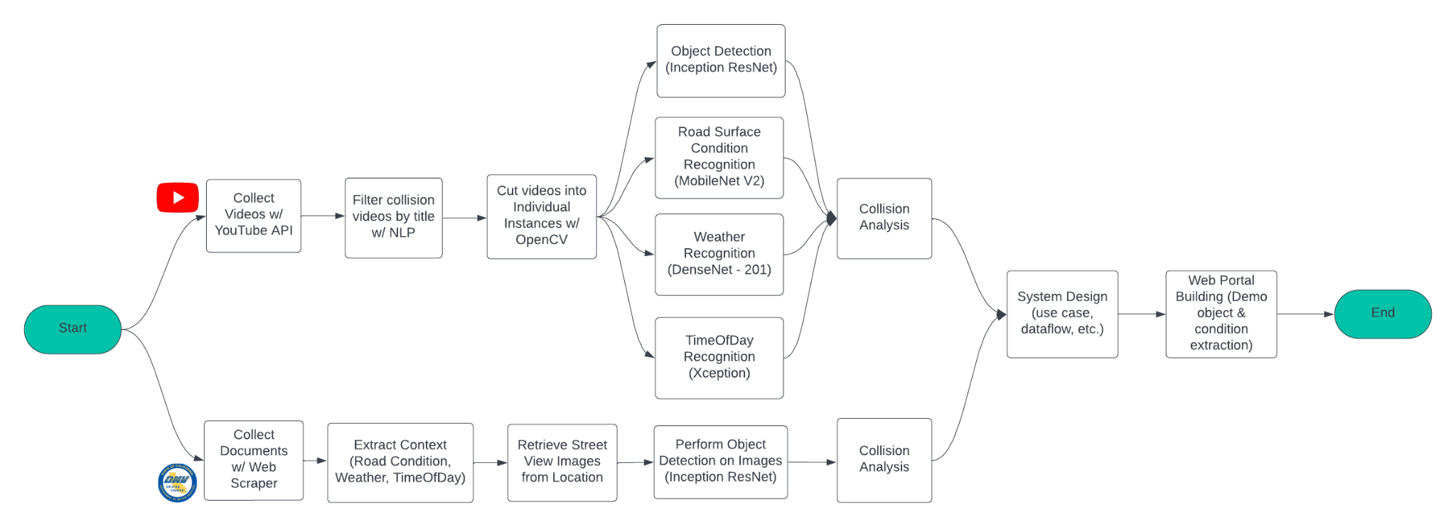
Methodology Diagram

Slide 7
02
Data Pre-Processing

Slide 8


Data Introduction
Dataset |  | Autonomous Vehicle Collision Reports | Wham Baam Teslacam Videos
Source |  | California Department of Motor Vehicles | YouTube Channel
Category |  | document | video
Data type |  | pdf | mp4
Size |  | 546 files | 557 videos
Collision type |  | AV Involved | AV Involved
Duration |  | 01/01/2019 - 10/16/2023 | 06/01/2020 - 11/26/2023
Conditions Availability | Weather | Y | Y
 | TimeOfDay | Y | Y
 | Road Surface | Y | Y

Slide 9
2.1
Document Data

Slide 10
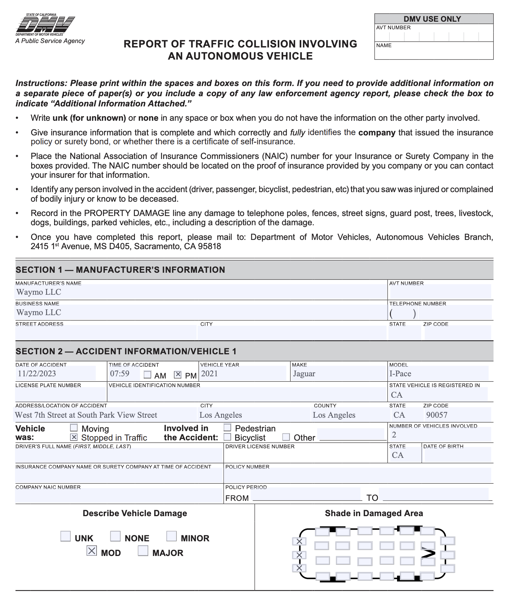
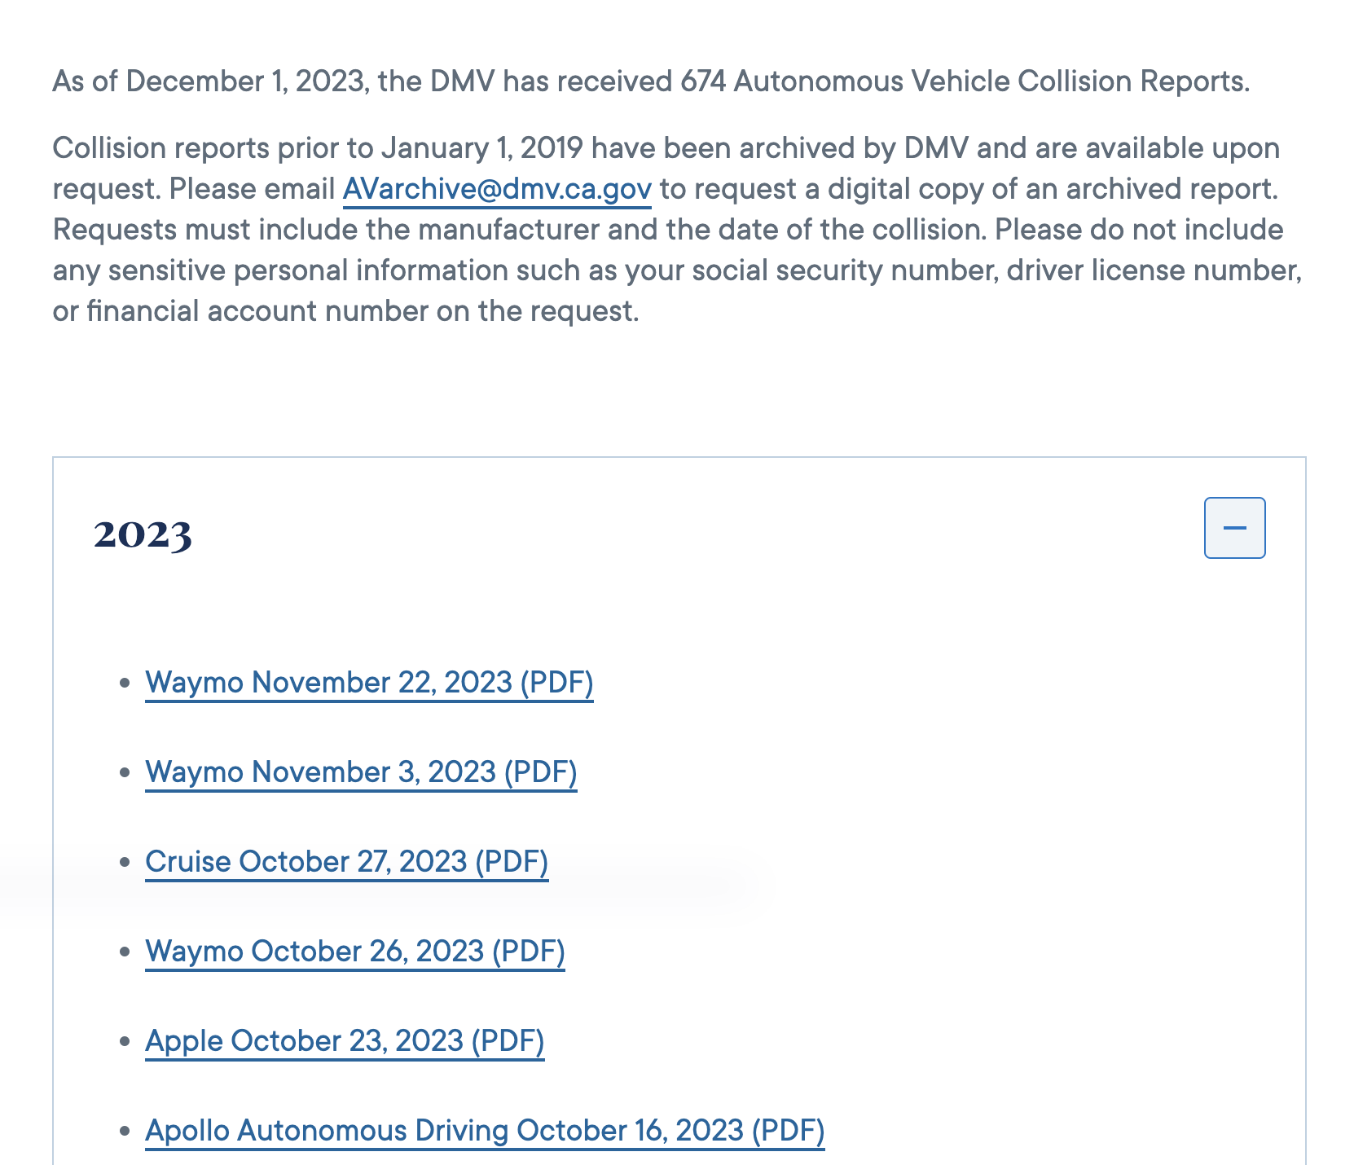
2.1.1 Document Raw Data

Slide 11
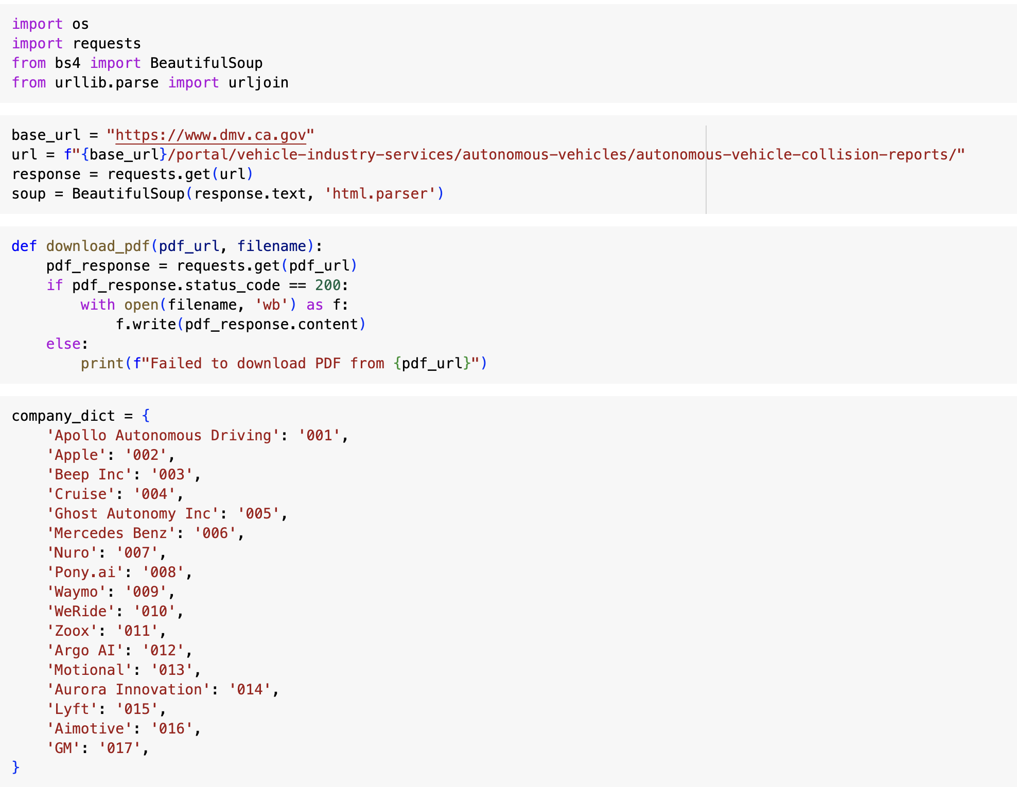
2.1.2 Document Data Collection
Get PDF files
Download from DMV website
PDF in 2019-2023
Rename files by customize rules
EX: 20231013002001
Date ->20231013
Apple->002
Index->001

Slide 12
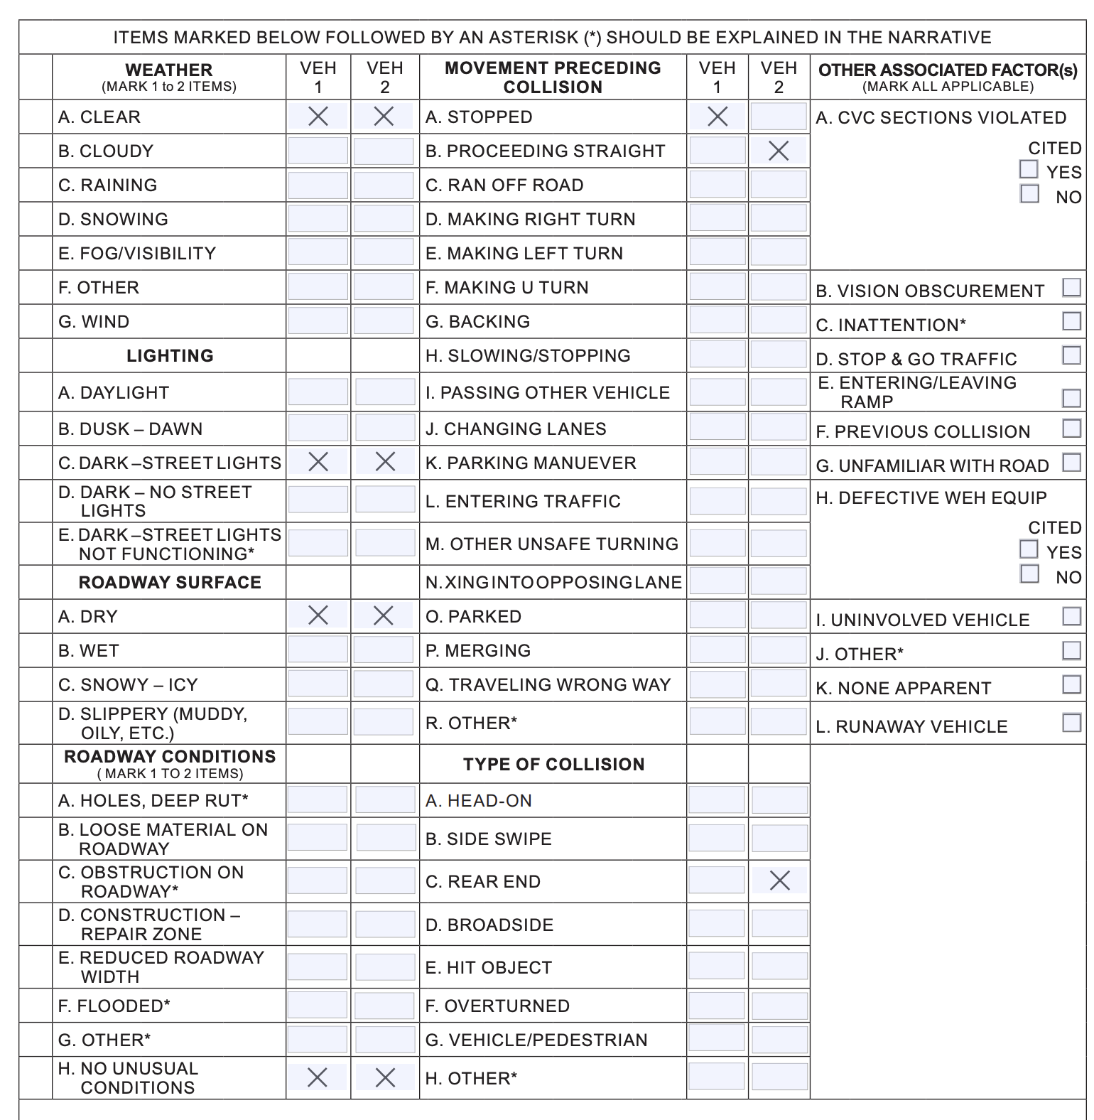
2.1.2 Document Data Processing
Extract from PDF files
Using PyPDF2 to extract useful information from PDF
Create DataFrame
Using Google API to get street view images

Slide 13
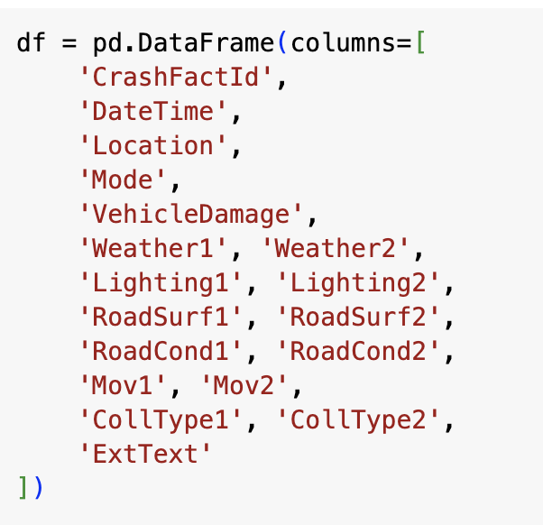
2.1.2 Document Data Processing
Extract from PDF files
Using PyPDF2 to extract useful information from PDF
Create DataFrame
Using Google API to get street view images

Slide 14
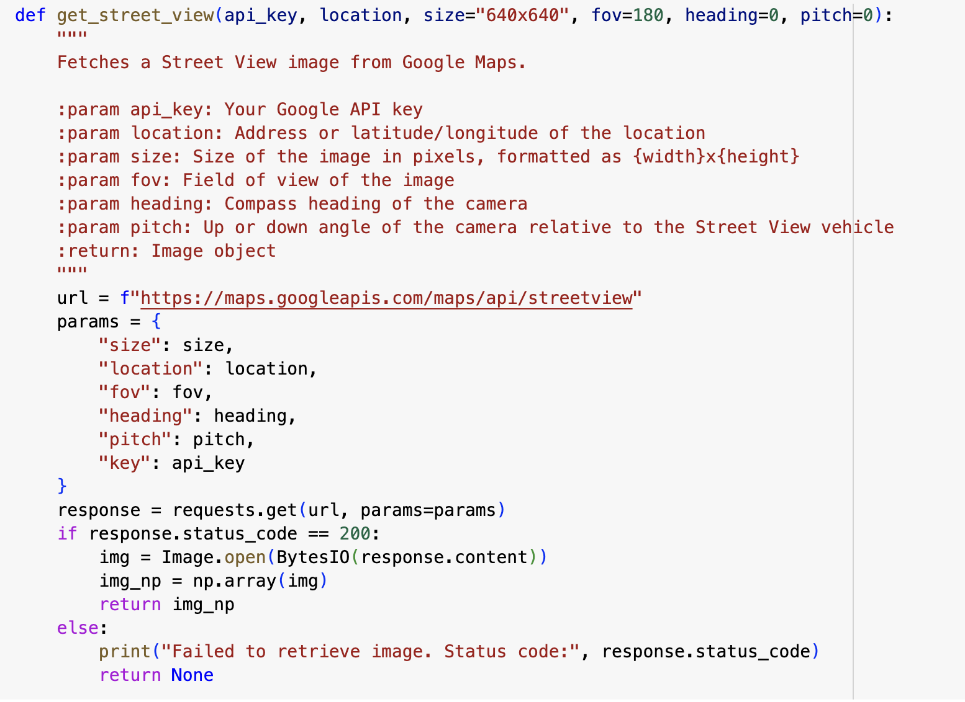
2.1.2 Document Data Processing
Extract from PDF files
Using PyPDF2 to extract useful information from PDF
Create DataFrame
Using Google API to get street view images

Slide 15
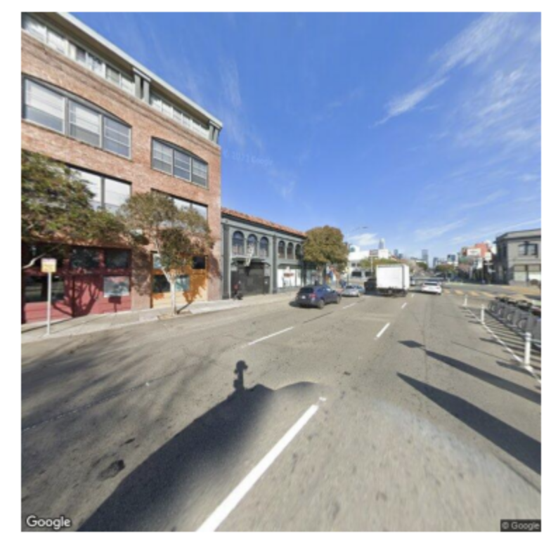
2.1.2 Document Data Processing
Extract from PDF files
Using PyPDF2 to extract useful information from PDF
Create DataFrame
Using Google API to get street view images

Slide 16
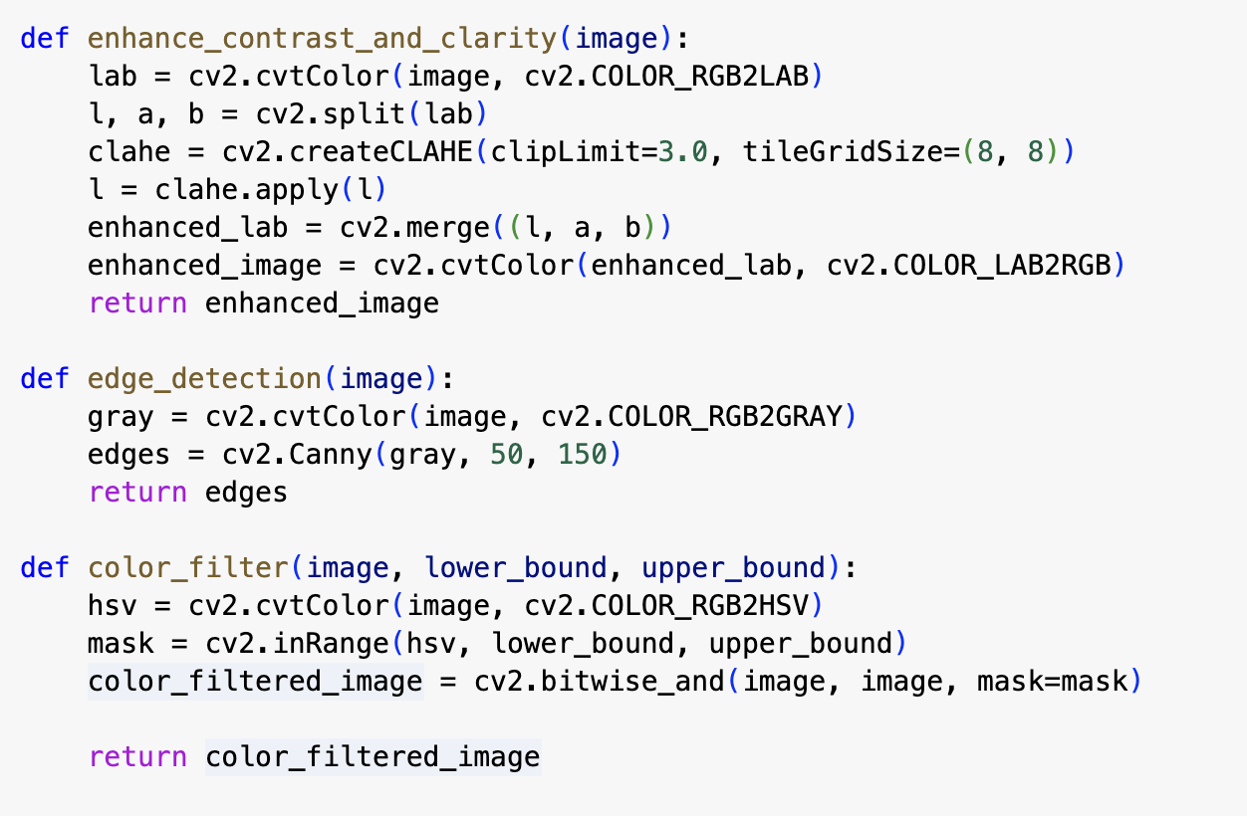
2.1.3 Document Data Transformation
Data Augmentation
Enhance contrast and clarity
Edge detection
Color filter

Slide 17
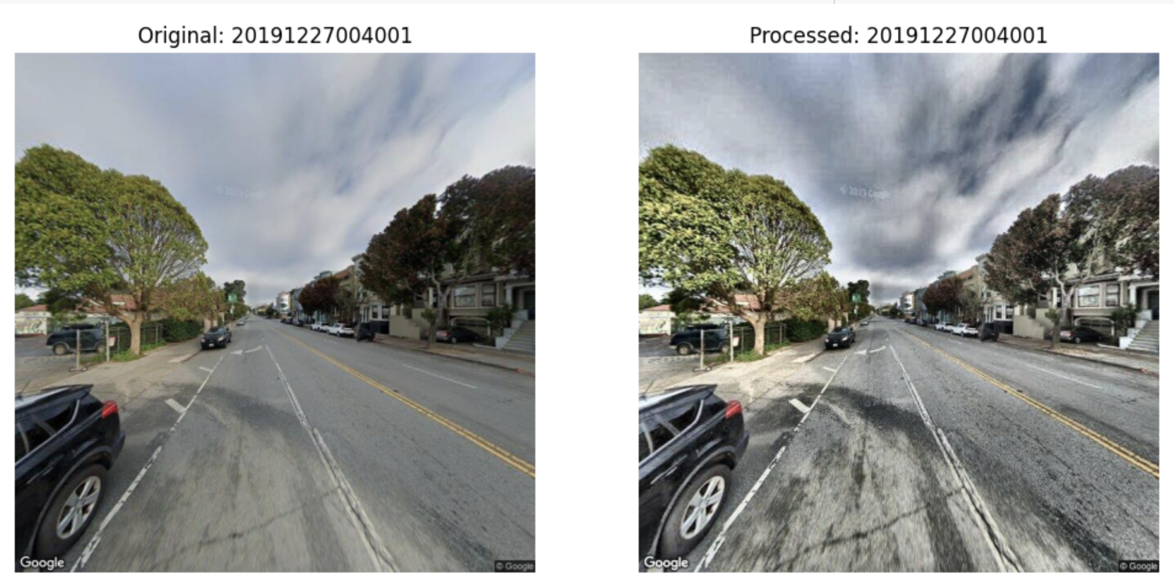
2.1.3 Document Data Transformation
Data Augmentation
Enhance contrast and clarity
Edge detection
Color filter

Slide 18
2.2
Video Data

Slide 19
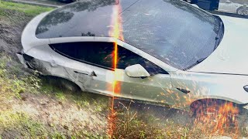
2.2 Video Raw Data
Raw video sample - a collection of crash cases

Slide 20
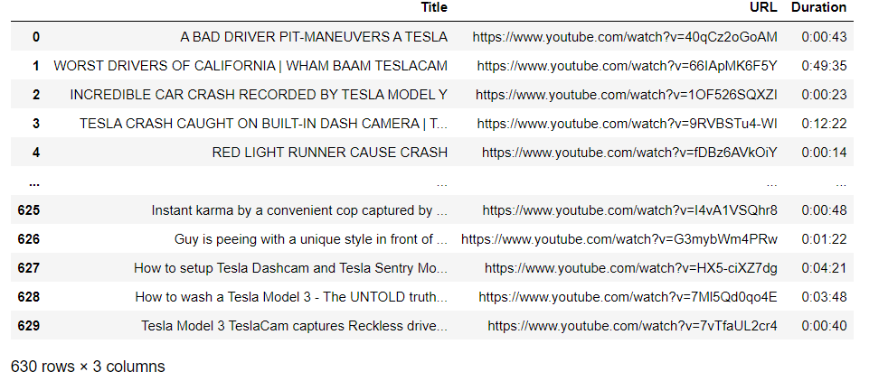
2.2.2 Video Data Collection
Used YouTube API to collect all the details about the videos, including Title, URL, Duration.
Stored as a csv file for later processing.

Slide 21
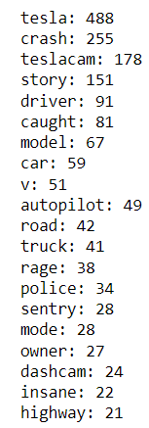
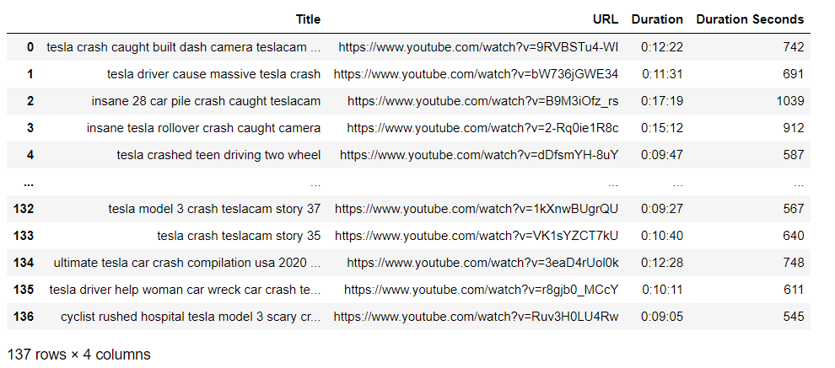
2.2.2 Video Data Processing
Filter out videos that are under 9 minutes and only keep videos related to “crash”

Slide 22


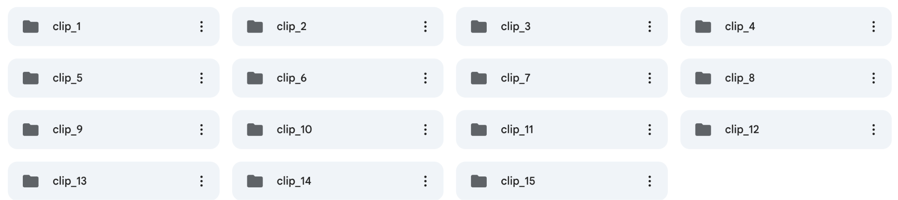
2.2.3 Video Data Processing
Use OCR in OpenCV to detect transition scene (red box with numbers) for each crash case
Cut the video into shorter clips so that each one is exactly one case.
Example:
1 YouTube Video Split into 15 short clips stored on Google Drive
Beginning frame sample

Slide 23
03
Data Preparation

Slide 24
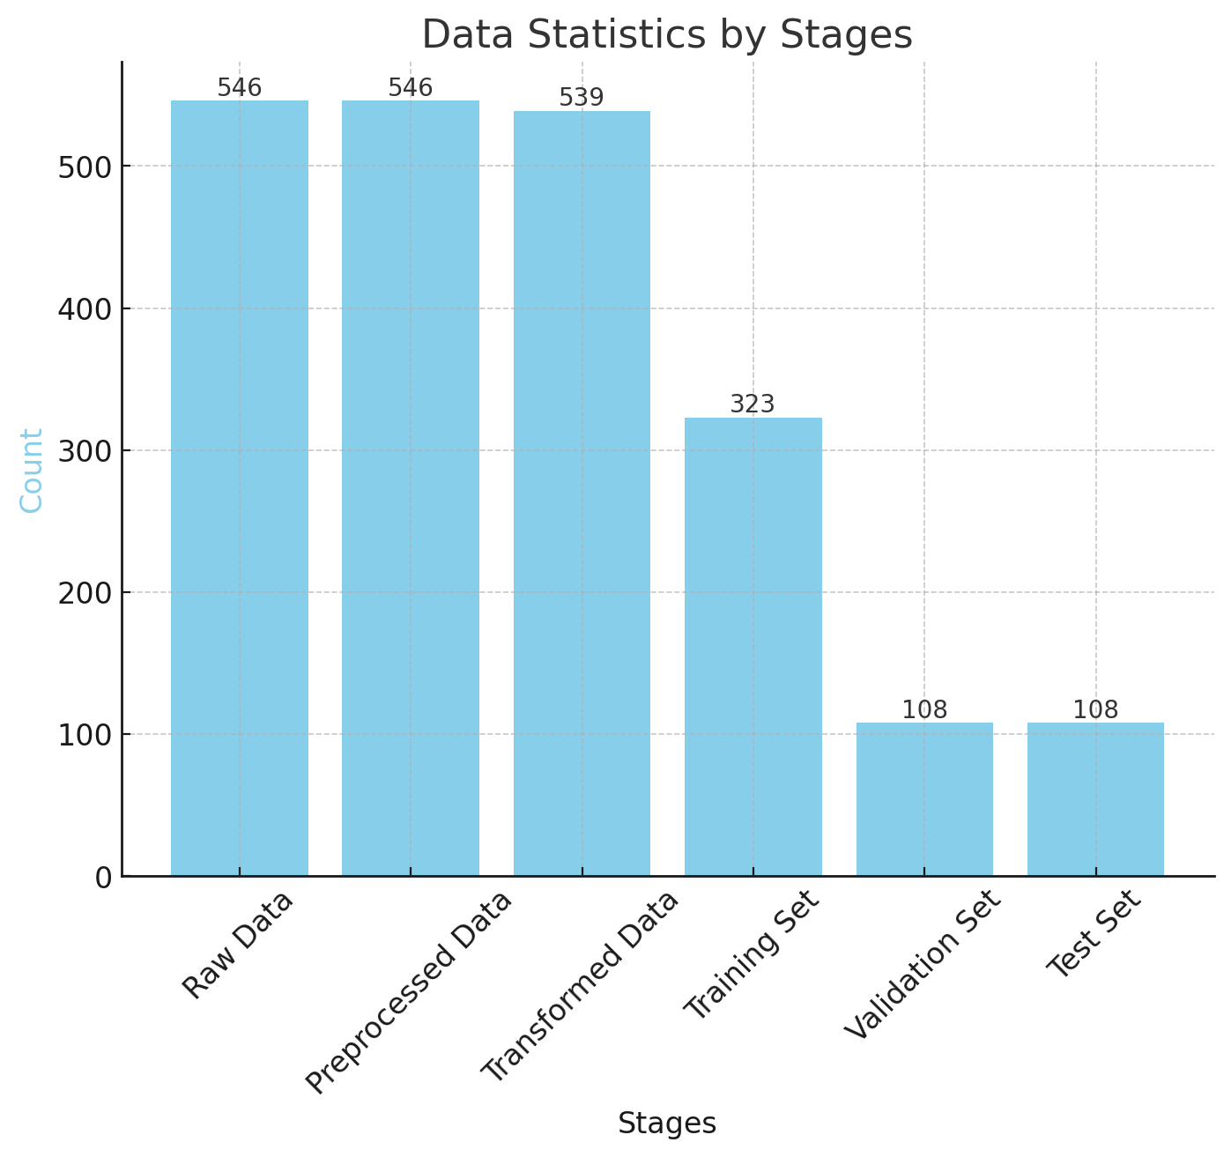
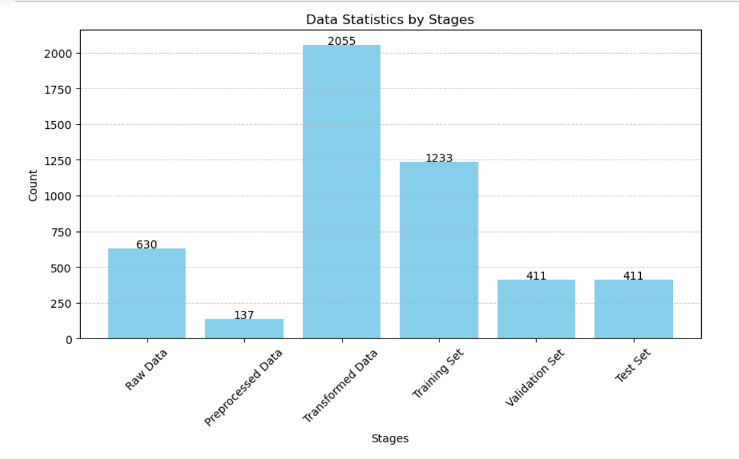
Data Preparation
Document Data:
Video Data:
Notes:
Observable progression of data volume through each phase.
Notable reduction post-transformation, achieved by removing erroneous or missing images to enhance data accuracy.

Slide 25
04
Data Analytics Results
Notes:
Lin

Slide 26
4.1
Document Data

Slide 27
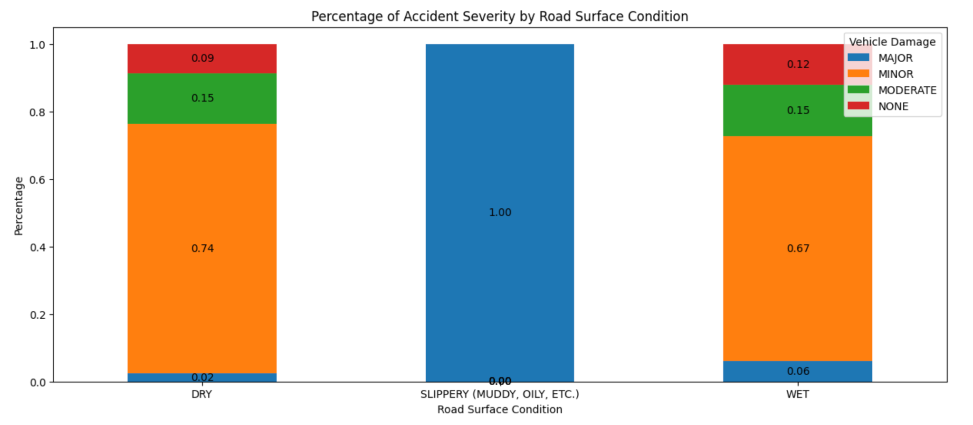
4.1 Document Data Analysis
Crash severity found on wet road surface was significantly higher than dry
Road surfaces in other worst weather cause more serious collisions
* NONE < MINOR < MODERATE < MAJOR

Slide 28
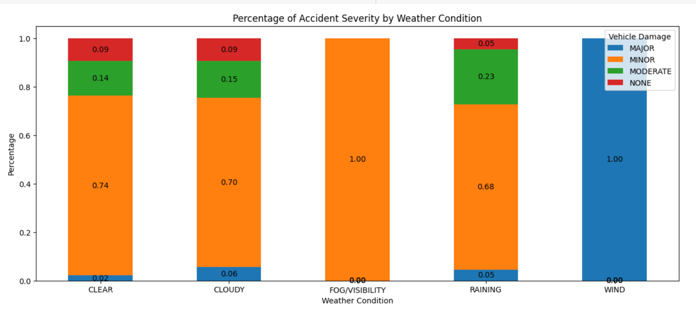
4.1 Document Data Analysis
Collision severity is highest in windy conditions
Cloudy also worse than other
Poor visibility influence the degree of damage
* NONE < MINOR < MODERATE < MAJOR

Slide 29
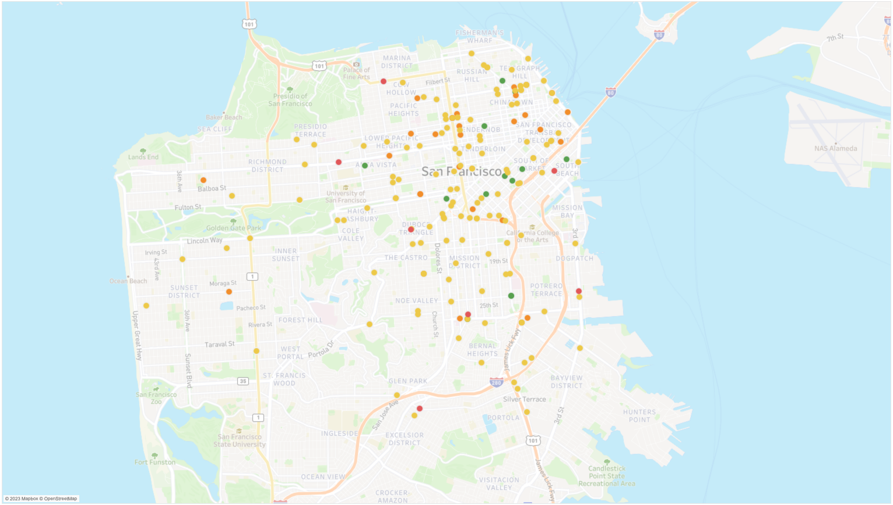
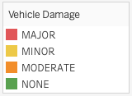
4.1 Document Data Analysis
Collision in SF
Different colors to mark different levels of damage
Most are minor level
Most in downtown

Slide 30
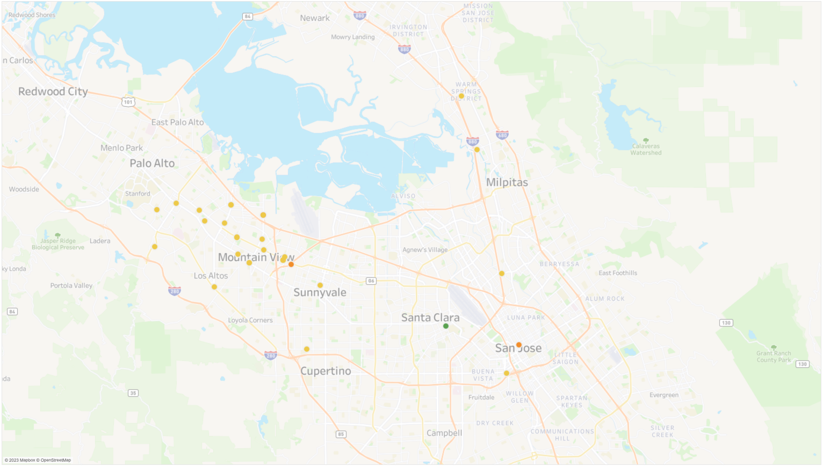
4.1 Document Data Analysis
Collision in South Bay
Most are minor
Many in downtown
Higher probability of collision along the highway

Slide 31
4.2
Video Data

Slide 32
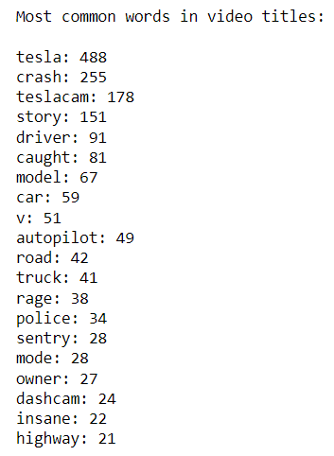
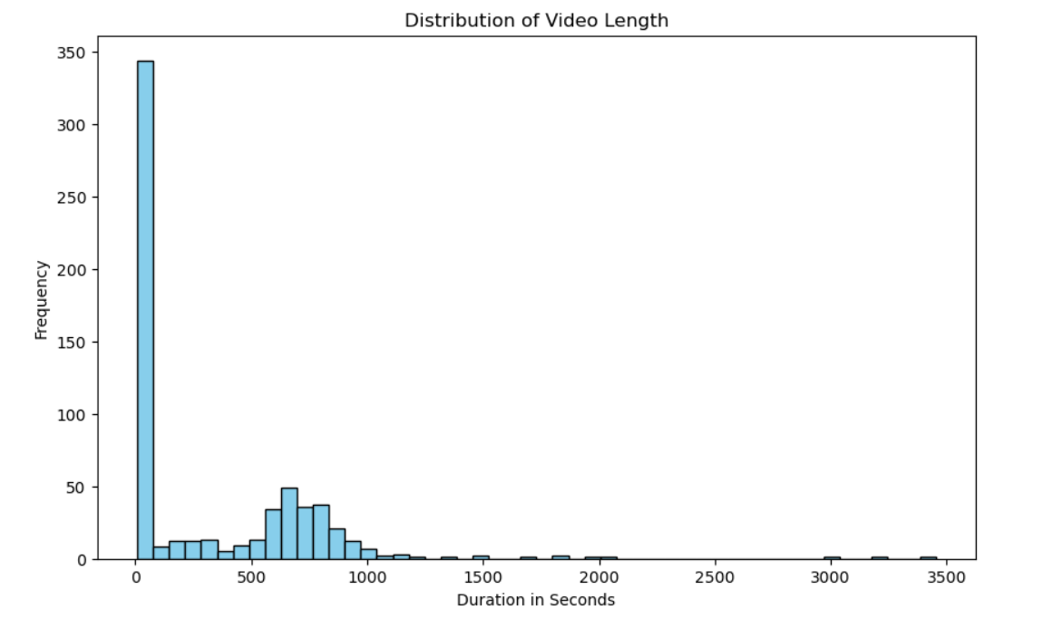
4.2 Video Data Analysis
55% of videos are under 100 seconds - shorts
Notes:
Lin 2055

Slide 33
05
Proposed ML Models

Slide 34
5.1 Goal of ML Models:
Extract objects of each collision case instance using street view images of document dataset and videos in video dataset.
Recognize conditions (time of day, weather, road surface) of each collision case instance.

Slide 35
5.2 Proposed ML Models:
Object Extraction:
Mask R-CNN Inception ResNet v2
Condition Recognition:
Time of Day: Xception
Weather: DenseNet-201
Road Surface: MobileNet v2

Slide 36
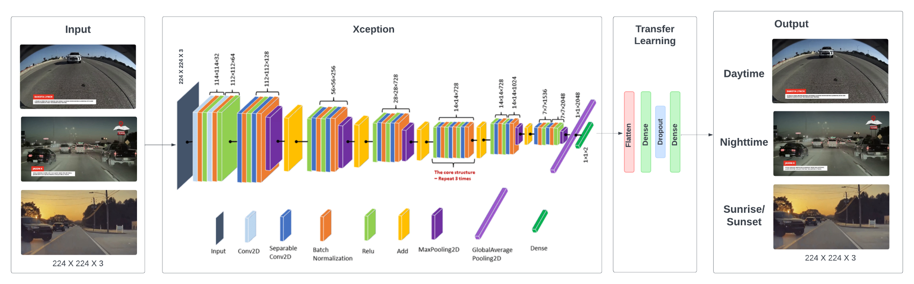
Time of Day Recognition - Xception
Model Architecture (Xception Based)
Notes:
Xception is a convolutional neural network that is 71 layers deep. You can load a pretrained version of the network trained on more than a million images from the ImageNet database

Slide 37
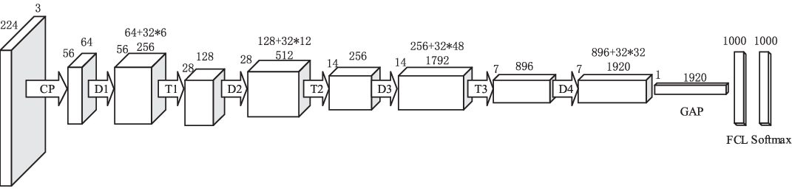
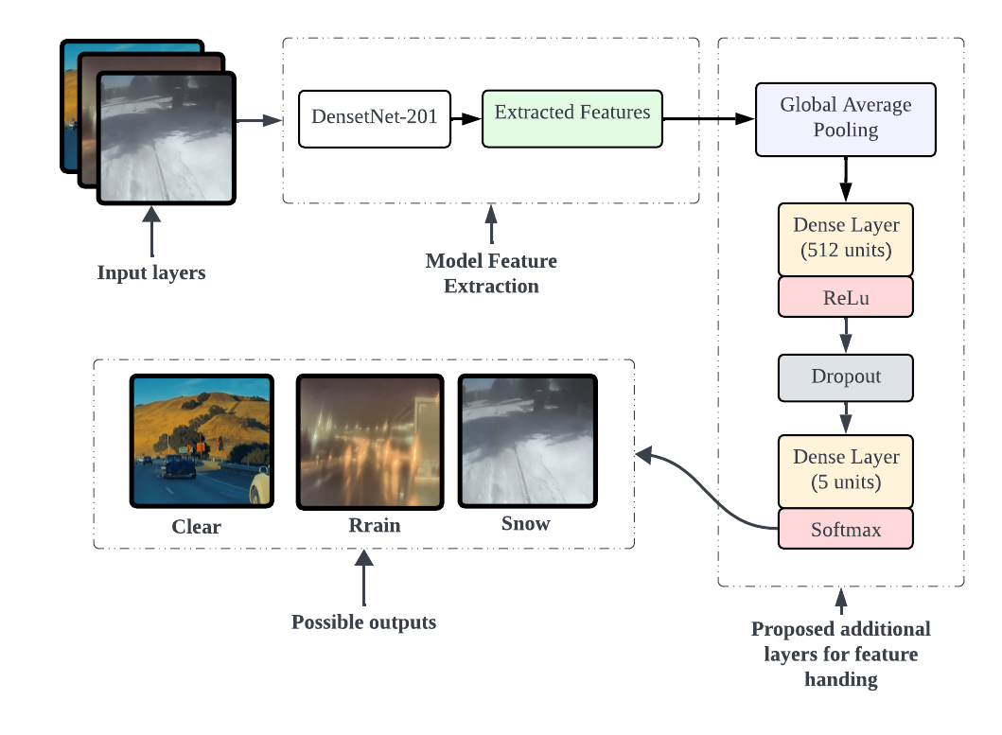
Weather Recognition - DenseNet-201
Model Architecture
(DenseNet 201 Based)

Slide 38
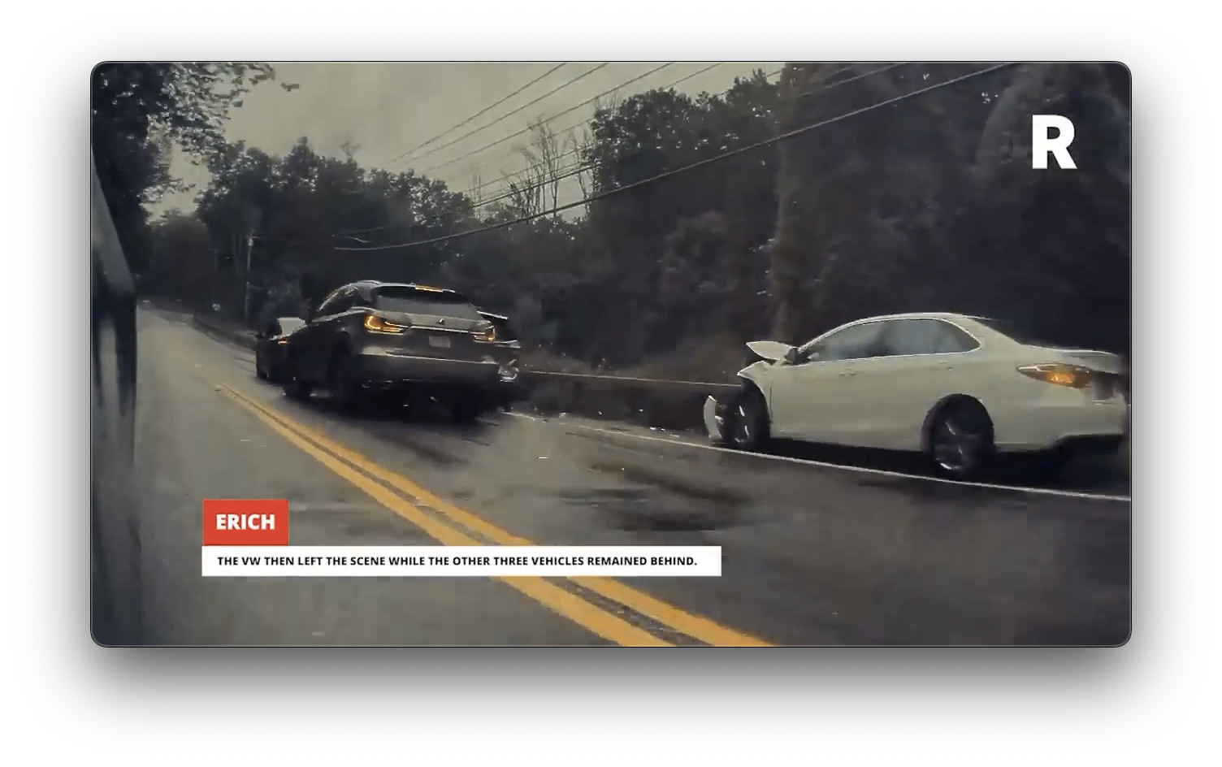
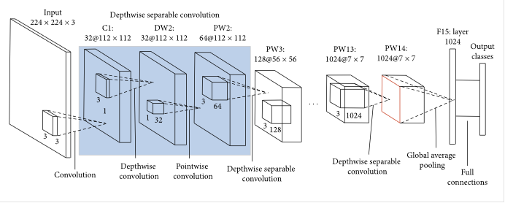
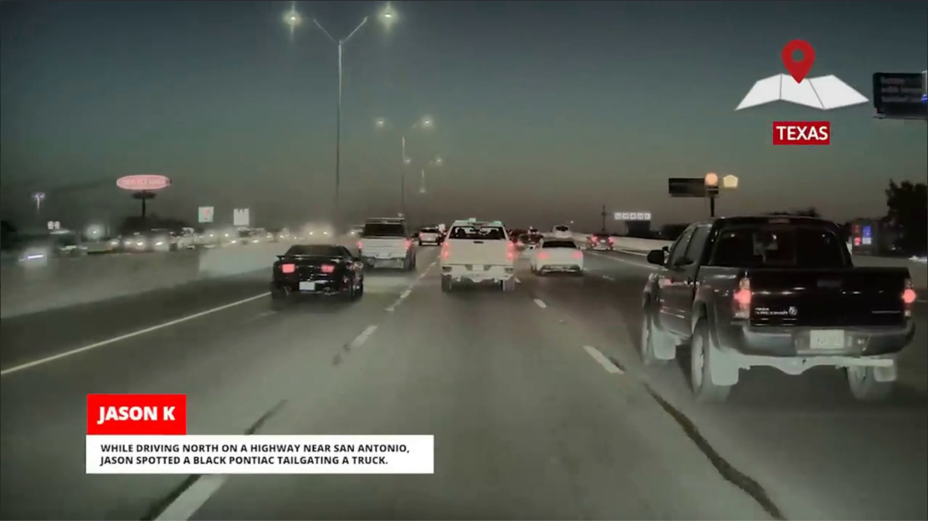
Road Surface Recognition - MobileNet v2
INPUT
OUTPUT
wet
dry
Model Architecture (MobileNet V2)

Slide 39
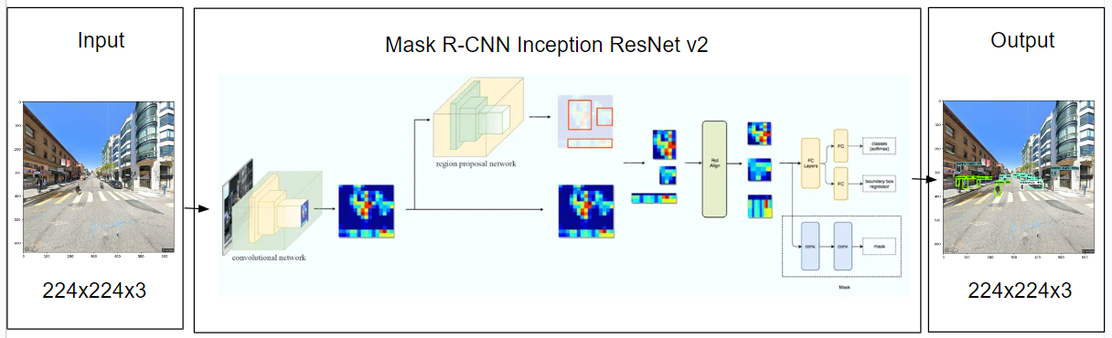
Mask R-CNN Inception ResNet v2
Model Architecture (Inception Resnet Based)
Notes:
Combines the benefits of inception networks and residual connections with Mask R-CNN backbone
Simultaneously performs object detection, object classification, and pixel-level segmentation

Slide 40
06
Model Results

Slide 41
6.1
Document Data

Slide 42
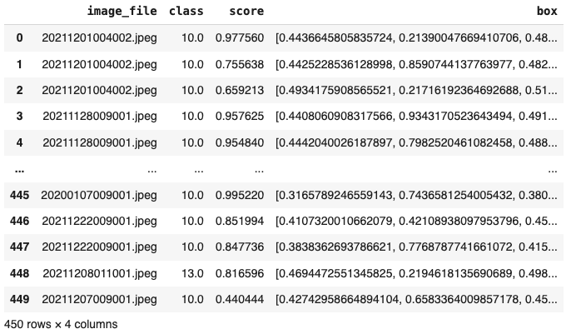
6.1.1 Results of Supplement Object Extract
Among 539 images in document dataset,
Detect 4 supplement stationary objects: traffic light, fire hydrant, stop sign, parking meter
Results:
Mask R-CNN Inception ResNet has detected 450 objects for 228 images.
Mask R-CNN Inception ResNet Detected Results

Slide 43
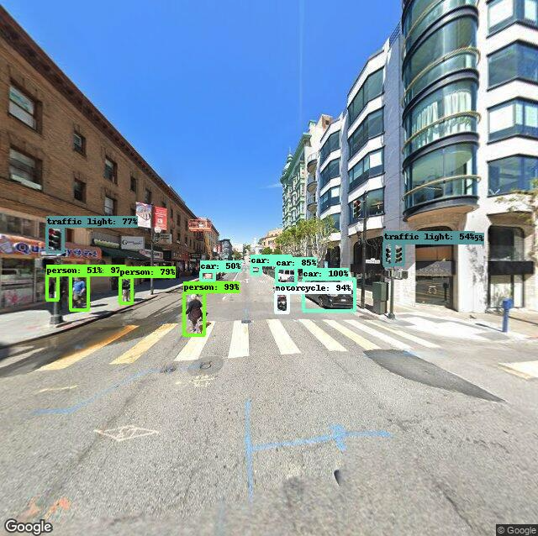
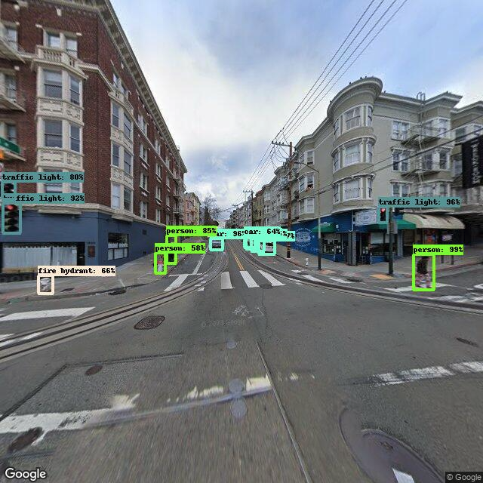
6.1.2 Result Sample
Mask R-CNN Inception ResNet V2 detect stationary objects from street view image of documents.
Sample:

Slide 44
6.2
Video Data

Slide 45
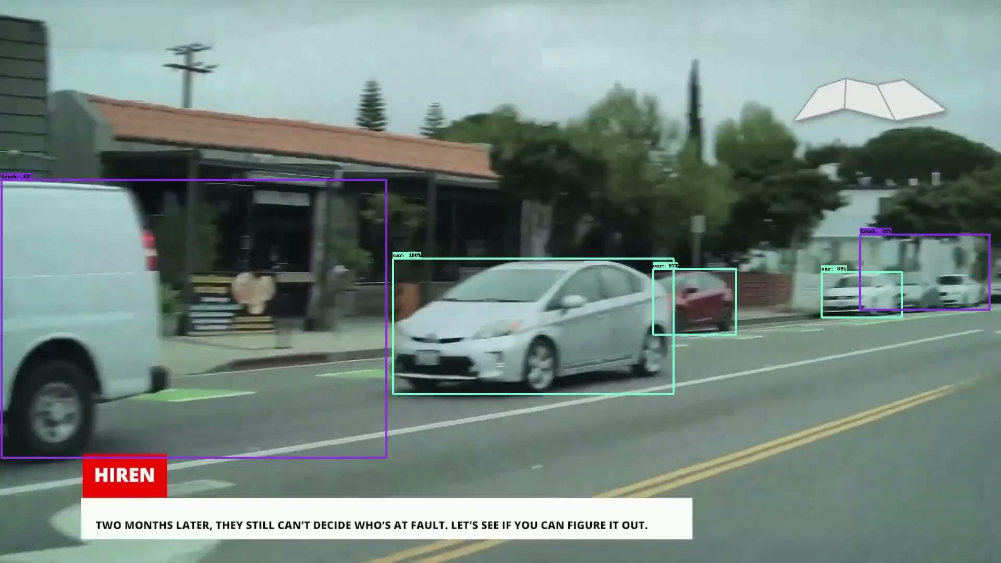
6.2.1 Object Detection Result
(Mask R-CNN Inception ResNet V2)
Mask R-CNN Inception ResNet V2 Detection
Notes:
Among all these objects detected, we would only focus on the stationary objects, such as traffic lights to reconstruct the scenario.

Slide 46
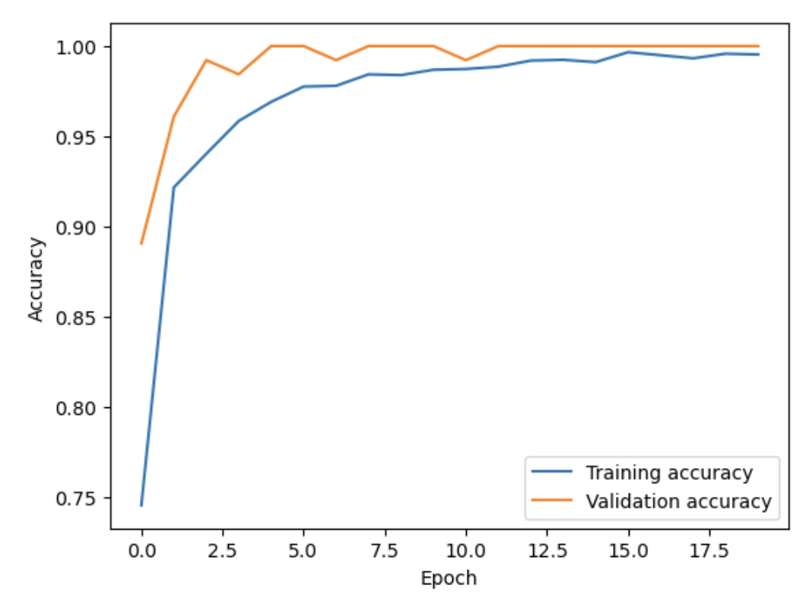
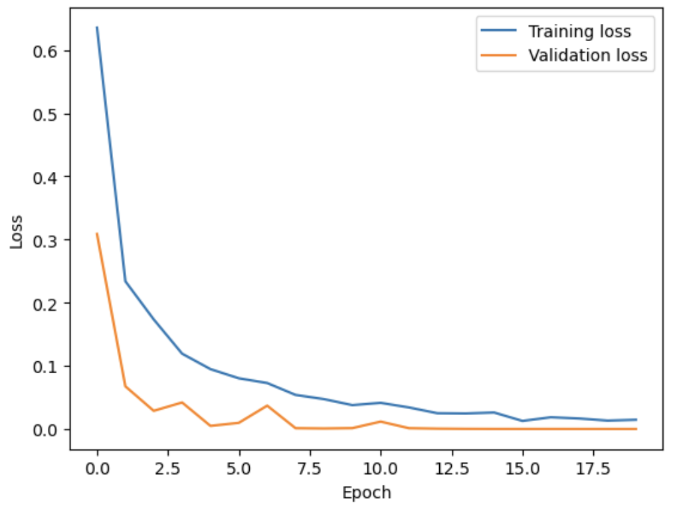
6.2.2 Time of Day Model (Xception)
Accuracy And Loss Of Transfer Learning Model (Xception Based)

Slide 47
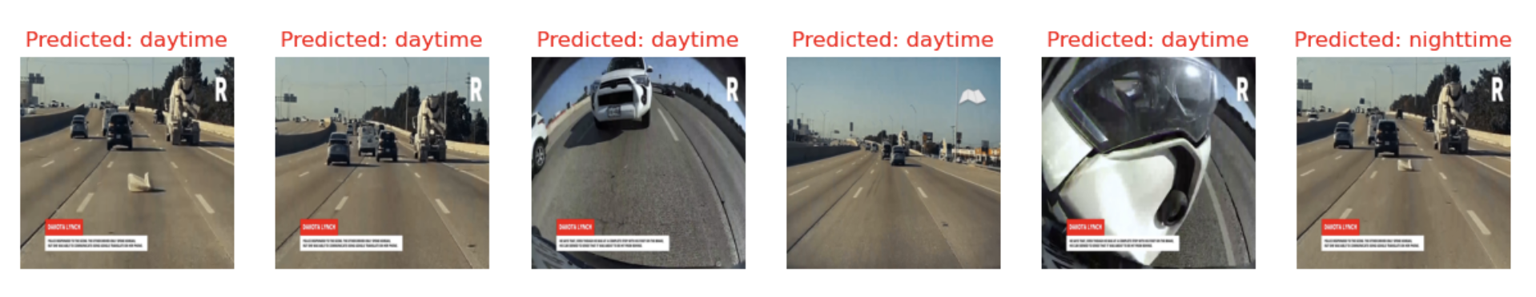
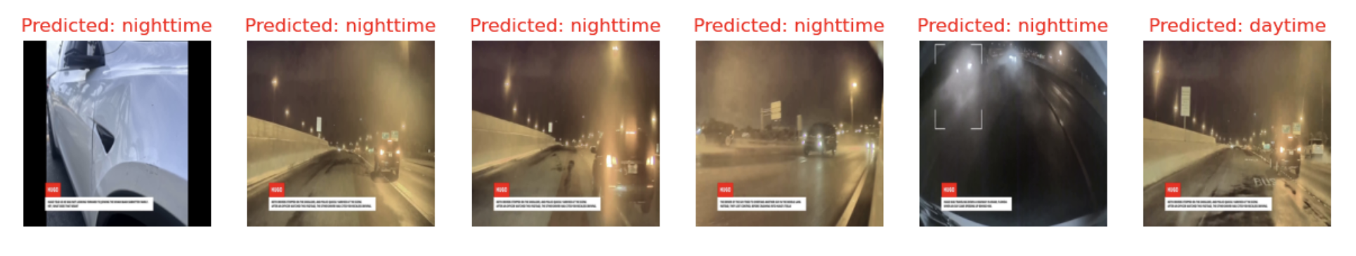
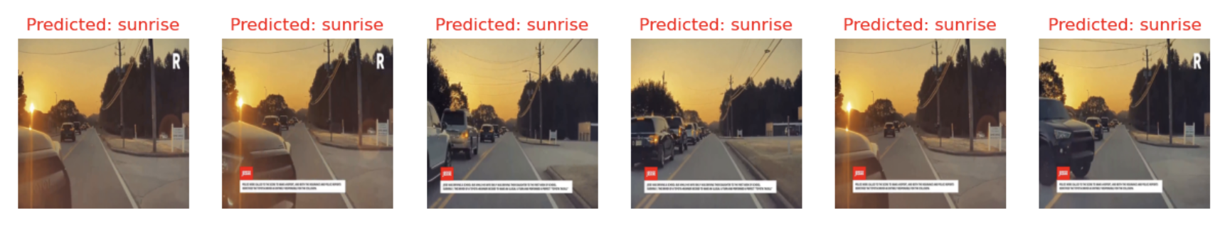
6.2.2 Time of Day Model Inference
Daytime
Nighttime
Sunrise/ Sunset
Transfer Learning Model Inference (Xception Based)

Slide 48
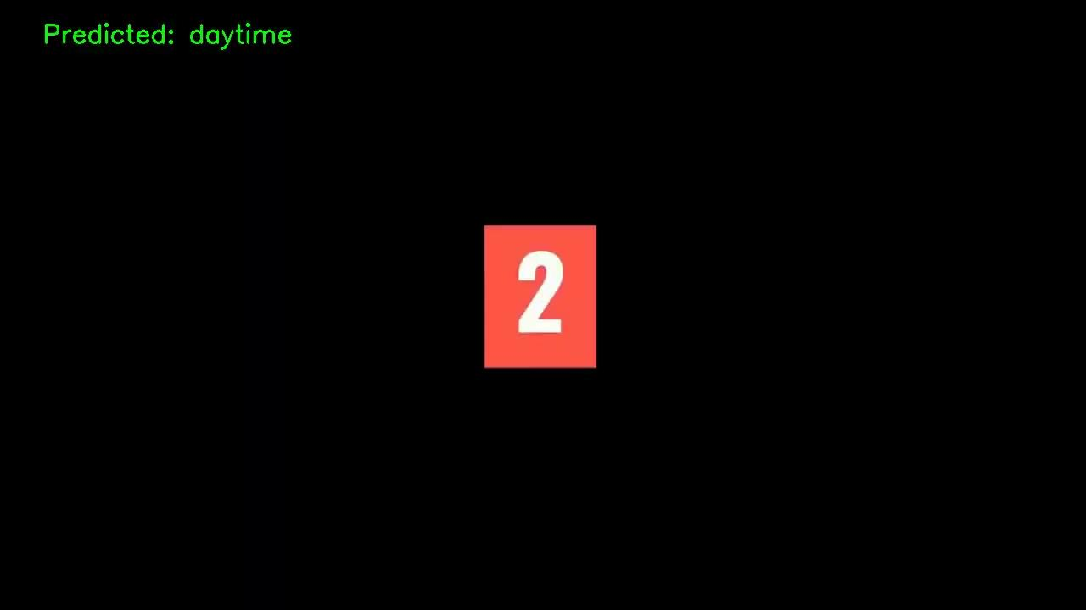
6.2.2 Time of Day Model Inference
Transfer Learning Model Inference (Xception Based)

Slide 49
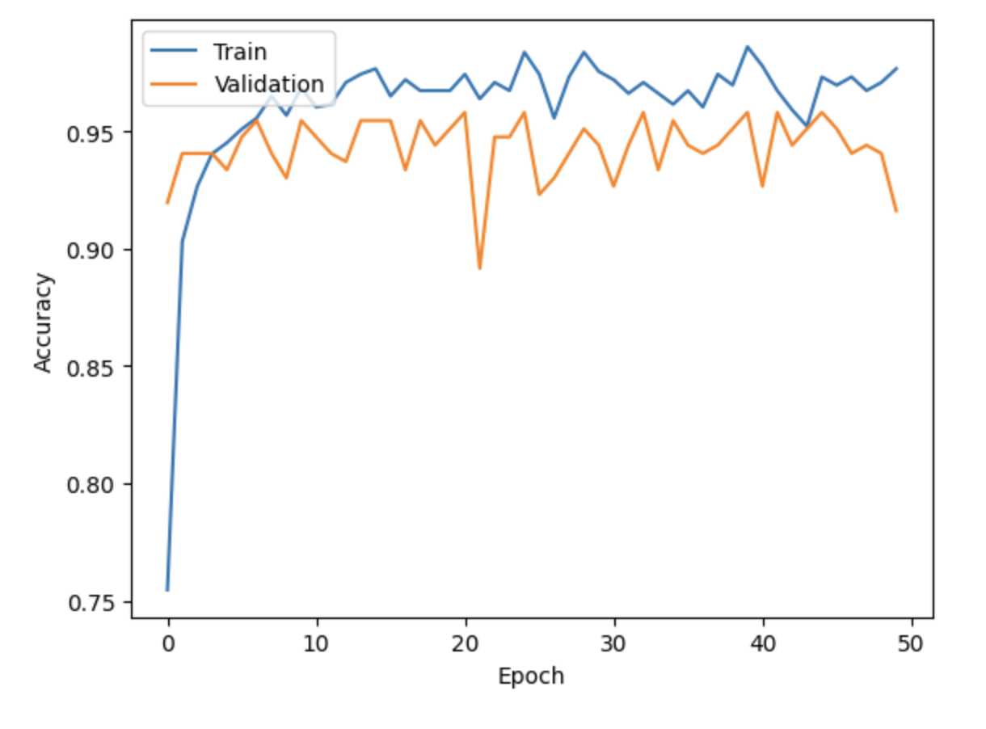
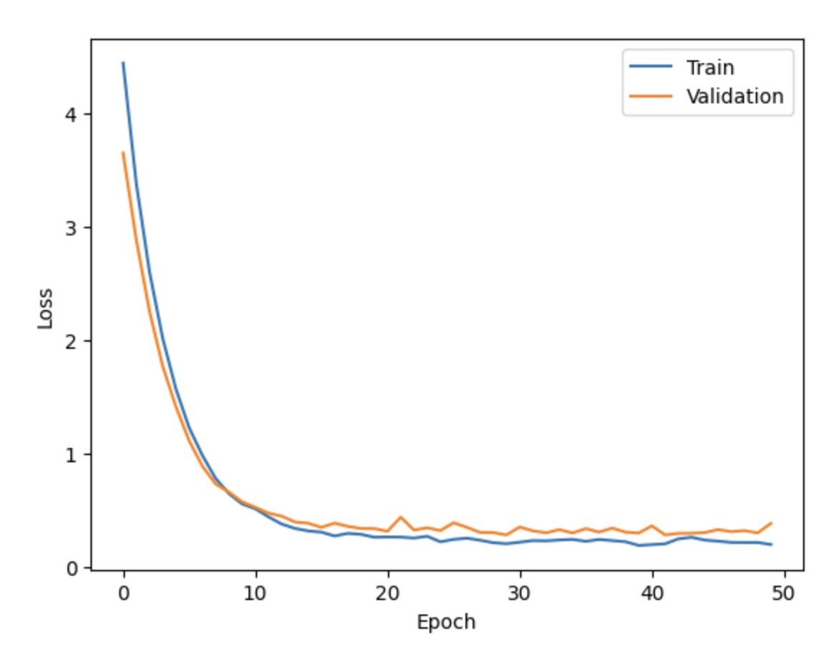
6.2.3 Road Surface Model (MobileNet V2)

Slide 50
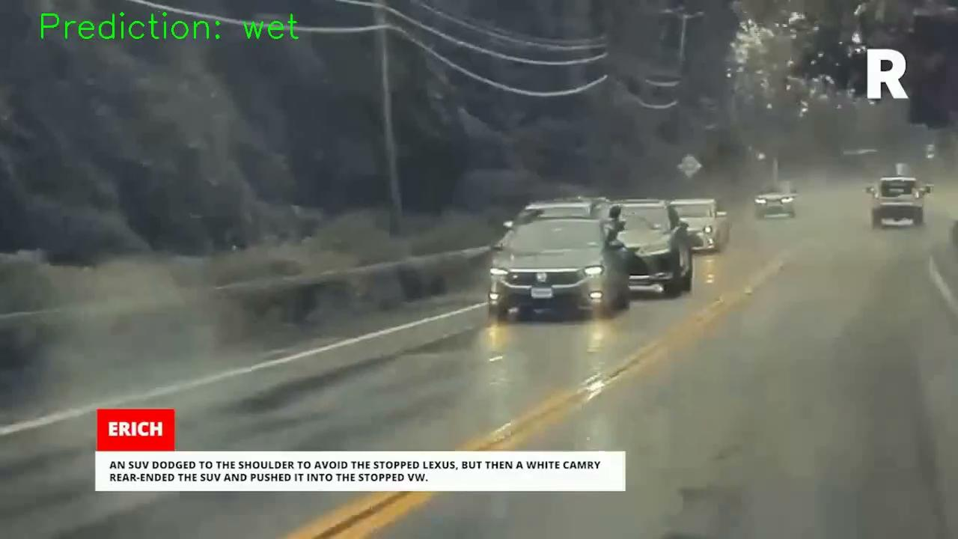
6.2.3 Road Surface Model Inference

Slide 51
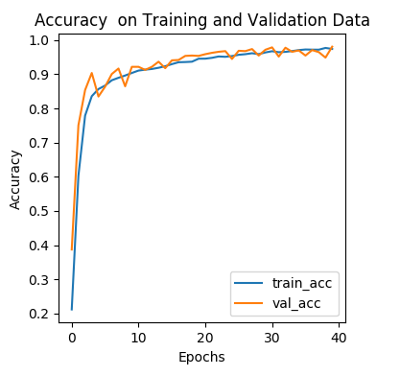
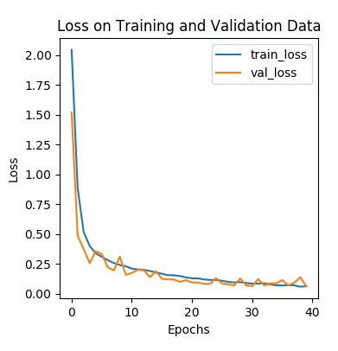
6.2.4 Weather Model (DenseNet - 201)

Slide 52
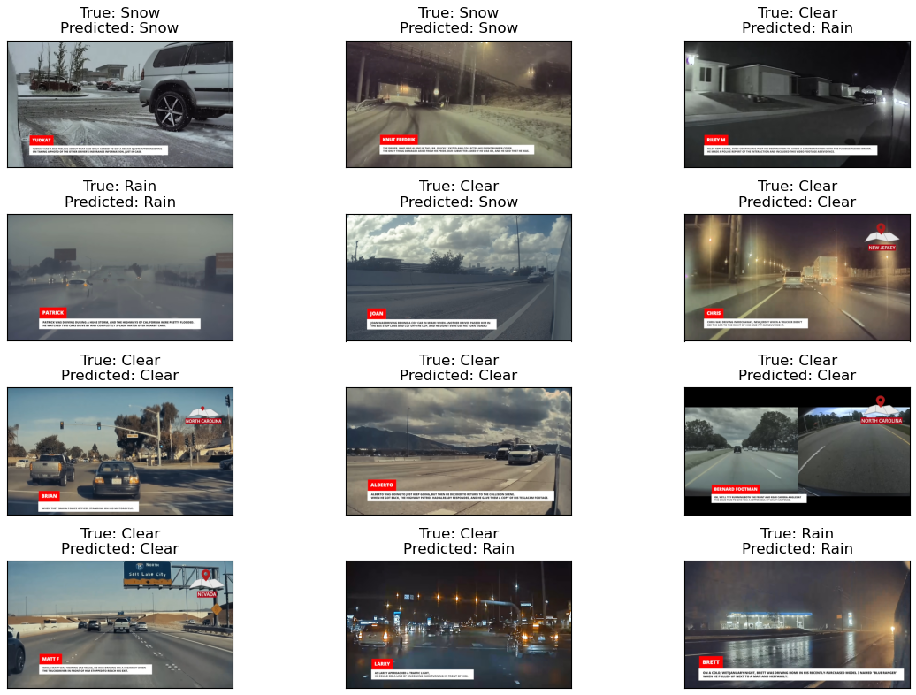
6.2.4 Weather Model Inference

Slide 53
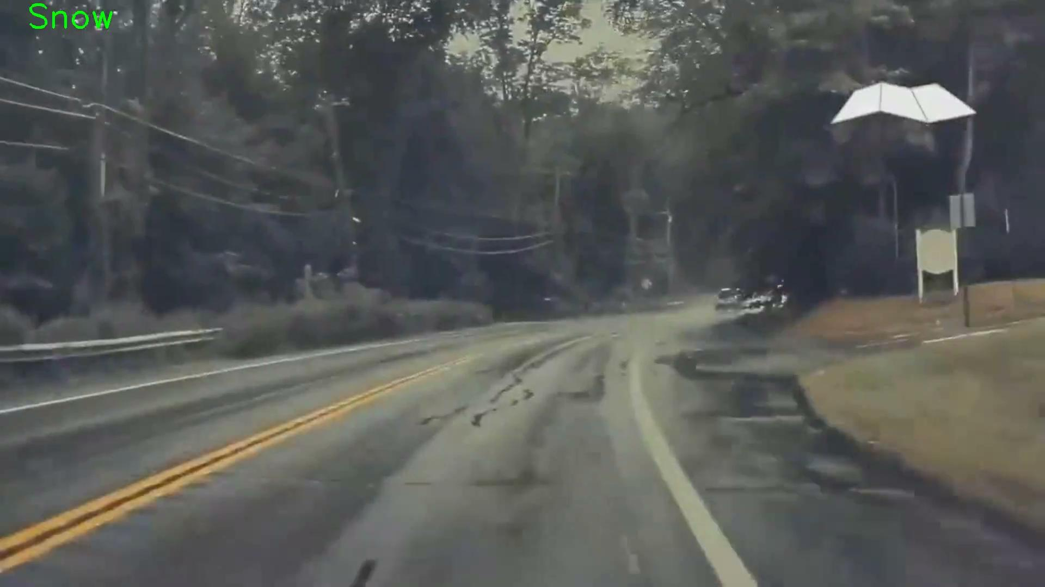
6.2.4 Weather Model Inference

Slide 54
6.3 Comparative ML Model Results
Table 1. Model Improvement Comparison
Table 2. Model Runtime Comparison
 | Model | Previous Accuracy | Current Accuracy
Time of Day Recognition | Xception - based | 93% | 99%
Weather Recognition | DenseNet 201 - based | 82% | 91%
Road Surface Recognition | MobileNet V2 - based | 59% | 95%
 | Runtime (CPU) | Runtime (GPU)
Time of Day Recognition | 4.131 seconds | 0.047 seconds
Weather Recognition | 21.37 seconds | 0.194 seconds
Road Surface Recognition | 3.186 seconds | 0.034 seconds
Notes:
Comparative Machine Learning Model Results

Slide 55

6.4 Integrated Output Video
Scenario 1: daytime clear

Slide 56
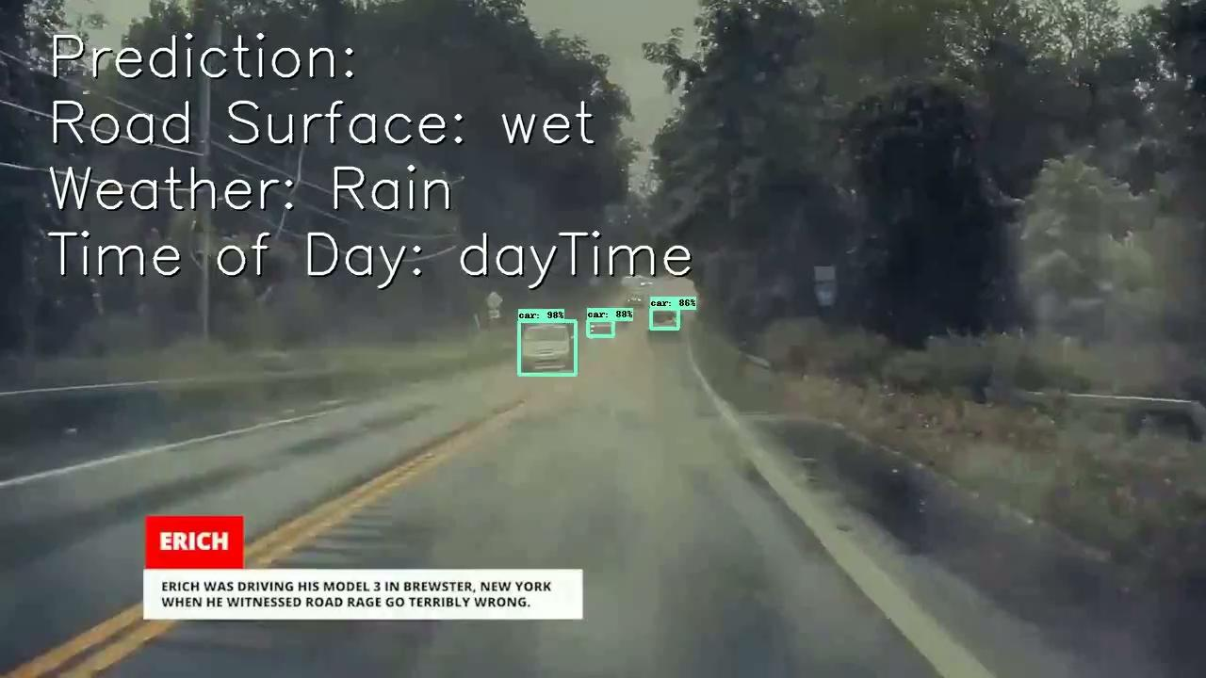
6.4 Integrated Output Video
Scenario 2: daytime rainy

Slide 57

6.4 Integrated Output Video
Scenario 3: nighttime clear

Slide 58

6.4 Integrated Output Video
Scenario 4: sunset clear

Slide 59
07
System Design

Slide 60

7.1 System Analysis

Slide 61

7.2 System Architecture

Slide 62










7.3 Dataflow
Input
Collision Analysis System
Output

Slide 63
7.4 Tools and Frameworks
 | Name | Function
Tool | Visual Studio Code (VS Code) | Integrated Development Environment (IDE)
 | GitHub | Version Control System (VCS)
Framework | Streamlit | Web Development
 | Jupyter Notebook | Interactive Computing Environment
 | OpenCV (cv2) | Computer Vision Library
 | Keras | Deep Learning Framework
 | TensorFlow Hub | Pre-trained Model Repository
Table 3. Tools and Frameworks Supporting the System

Slide 64




7.5 Web Portal Structure
1.
Homepage:
Introduction, usage tutorial and license.
2.
Map Dashboard:
Statistical and interactive dashboard in mao format.
3.
PDF Analyzer:
Allow PDF document upload and analysis.
Collision condition and objects extracted as table.
Collision Analysis System
4.
Video Analyzer:
Allow MP4 video upload and processing.
Detect objects and conditions and output new video.

Slide 65


7.5 Web Portal Interface
Homepage:

Slide 66

7.5 Web Portal Interface
Dashboard:

Slide 67

7.5 Web Portal Interface
PDF Analyzer:

Slide 68

7.5 Web Portal Interface
Video Analyzer:

Slide 69

7.6 Web Portal Demo: Live
Autonomous Vehicle
Collision Analysis System
*Please contact us if you would like to access the portal.

Slide 70

7.6 Web Portal Demo: Recording

Slide 71
7.7 Web Portal Next Stage Plan
Allow users to click and download original PDF documents and videos from Map dashboard.
Allow users to use PDF Analyzer and Video Analyzer to add new data and integrate and display new data in Map dashboard.
Add more filters to allow further analysis.
…

Slide 72
Reference
[1] Stanton, N.A., Salmon, P.M., Walker, G.H., Stanton, M., 2019. Models and methods for collision analysis: A comparison study based on the Uber collision with a pedestrian. Saf. Sci. 120, 117-128.
[2] D. S. Iakovlev, "Collision Risk Analysis to Ensure the Safety of Autonomous Vehicle Motion Control," 2021 International Russian Automation Conference (RusAutoCon), Sochi, Russian Federation, 2021, pp. 644-649, doi: 10.1109/RusAutoCon52004.2021.9537403.
[3] Intersection two-vehicle crash scenario specification for automated vehicle safety evaluation using sequence analysis and Bayesian networks (2022). https://doi.org/10.1016/j.aap.2022.106814.
[4] Comparison of automated vehicle struck-from-behind crash rates with national rates using naturalistic data (2021). https://doi.org/10.1016/j.aap.2021.106056
[5] What can we learn from autonomous vehicle collision data on crash severity? A cost-sensitive CART approach (2022). https://doi.org/10.1016/j.aap.2022.106769.
[6] Traffic Accidents with Autonomous Vehicles: Type of Collisions, Manoeuvres and Errors of Conventional Vehicles’ Drivers (2020). https://doi.org/10.1016/j.trpro.2020.03.003.
[7] Ma, X., Yu, Q., & Liu, J. (2022). Modeling Urban Freeway Rear-End Collision Risk Using Machine Learning Algorithms. Sustainability, 14(19), 12047. MDPI AG. Retrieved from http://dx.doi.org/10.3390/su141912047
[8] He, Y., Feng, J., Wei, K., Cao, J., Chen, S., & Wan, Y. (2023). Modeling and simulation of lane-changing and collision avoiding autonomous vehicles on superhighways. Physica A: Statistical Mechanics and its Applications, 609, 128328.

Slide 73
Reference
[9] H. -H. Hsu, N. -F. Huang and C. -H. Han, "Collision Analysis to Motor Dashcam Videos With YOLO and Mask R-CNN for Auto Insurance," 2020 International Conference on Intelligent Engineering and Management (ICIEM), London, UK, 2020, pp. 311-315, doi: 10.1109/ICIEM48762.2020.9160263.
[10] B. Olofsson and L. Nielsen, "Using Crash Databases to Predict Effectiveness of New Autonomous Vehicle Maneuvers for Lane-Departure Injury Reduction," in IEEE Transactions on Intelligent Transportation Systems, vol. 22, no. 6, pp. 3479-3490, June 2021, doi: 10.1109/TITS.2020.2983553.
[11] Rea, R. V., Johnson, C. J., Aitken, D. A., Child, K. N., &amp; Hesse, G. (2018). Dash cam videos on YouTubeTM offer insights into factors related to moose-vehicle collisions. Accident Analysis &amp;amp; Prevention, 118, 207–213. https://doi.org/10.1016/j.aap.2018.02.020
[12] Morris, C., & J. Yang, J. (2020). Understanding multi-vehicle collision patterns on freeways—a machine learning approach. Infrastructures, 5(8), 62. https://doi.org/10.3390/infrastructures5080062
AI-enabled testing market size & share [2023 global report]. AI-enabled Testing Market Size & Share [2023 Global Report]. (n.d.). https://www.grandviewresearch.com/industry-analysis/ai-enabled-testing-market-report
Autonomous Vehicle Market (by application: Defense, Transportation; by level of automation: Level 1, level 2, level 3, level 4, level 5; by propulsion: Semi-autonomous, fully autonomous; by vehicle: Passenger Car, commercial vehicle) - global industry analysis, size, share, growth, trends, regional outlook, and forecast 2023 - 2032. Precedence Research. (n.d.). https://www.precedenceresearch.com/autonomous-vehicle-market

Slide 74
Reference
Future Market Insights. (n.d.). Automation testing market. Future Market Insights. https://www.futuremarketinsights.com/reports/automation-testing-market
Kriston, A., Hamon, R., Fernandez Llorca, D., Junklewitz, H., Sanchez Martin, J.I. and Gomez Gutierrez, E., Toward explainable, robust and fair AI in automated and autonomous vehicles, EUR 31305 EN, Publications Office of the European Union, Luxembourg, 2023, ISBN 978-92-76-58978-5, doi:10.2760/95650, JRC130621.
Li, S., Li, W., Li, P. et al. Novel Test Scenario Generation Technology for Performance Evaluation of Automated Vehicle. Int.J Automot. Technol. 23, 1295–1312 (2022). https://doi.org/10.1007/s12239-022-0113-z
Horel et al., "Using Formal Conformance Testing to Generate Scenarios for Autonomous Vehicles," 2022 Design, Automation & Test in Europe Conference & Exhibition (DATE), Antwerp, Belgium, 2022, pp. 532-537, doi: 10.23919/DATE54114.2022.9774581.
J. Gao, W. Wu and O. -E. -K. Aktouf, "Adequate Testing Unmanned Autonomous Vehicle Systems - Infrastructures, Approaches, Issues, Challenges, and Needs," 2022 IEEE International Conference on Service-Oriented System Engineering (SOSE), Newark, CA, USA, 2022, pp. 154-164, doi: 10.1109/SOSE55356.2022.00025.
He, Y., Razi, M., Gao, J., &amp; Tao, C. (2023). A framework for autonomous vehicle testing using semantic models. 2023 IEEE International Conference On Artificial Intelligence Testing (AITest). https://doi.org/10.1109/aitest58265.2023.00020

Slide 75
Reference
Fujita, H., Itagaki, M., Ichikawa, K., Hooi, Y. K., Kawano, K., & Yamamoto, R. (2020). Fine-tuned Pre-trained Mask R-CNN Models for Surface Object Detection. arXiv preprint arXiv:2010.11464.
Raj, B. (2020, July 31). A simple guide to the versions of the inception network. Medium. https://towardsdatascience.com/a-simple-guide-to-the-versions-of-the-inception-network-7fc52b863202.
Ren et al, “Faster R-CNN: Towards Real-Time Object Detection with Region Proposal Networks”, NIPS 2015 Figure copyright 2015, Ross Girshick; reproduced with permission.
Solawetz, J. (2023, January 25). What is Yolov8? the ultimate guide. Roboflow Blog. https://blog.roboflow.com/whats-new-in-yolov8/
Chollet, F. (2017, April 4). Xception: Deep learning with depthwise separable convolutions. arXiv.org. https://arxiv.org/abs/1610.02357
K. He, X. Zhang, S. Ren, and J. Sun. Deep residual learning for image recognition. arXiv preprint arXiv:1512.03385, 2015.
J. Jin, A. Dundar, and E. Culurciello. Flattened convolutional neural networks for feedforward acceleration. arXiv preprint arXiv:1412.5474, 2014.
X. Wu, R. Liu, H. Yang, and Z. Chen, "An Xception Based Convolutional Neural Network for Scene Image Classification with Transfer Learning," 2020 2nd International Conference on Information Technology and Computer Application (ITCA), Guangzhou, China, 2020, pp. 262-267, doi: 10.1109/ITCA52113.2020.00063.

Slide 76

Thanks!
Q & A
DATA298B
Dr. Jerry Gao, Dr. Lee C. Chang
Group 4: Johnny Qiu, Lin Zhu, Manyu Zhang, Yuan Pan

